Slide 1
ERASMUS GREECE 2017

Slide 2
SATURDAY
Our visit in Greece started with a 6 hours jorney by plane from Warsaw to Athens. We were welcomed at airport by ours hosts and taken to their homes where we spent the rest of a day.

Slide 3
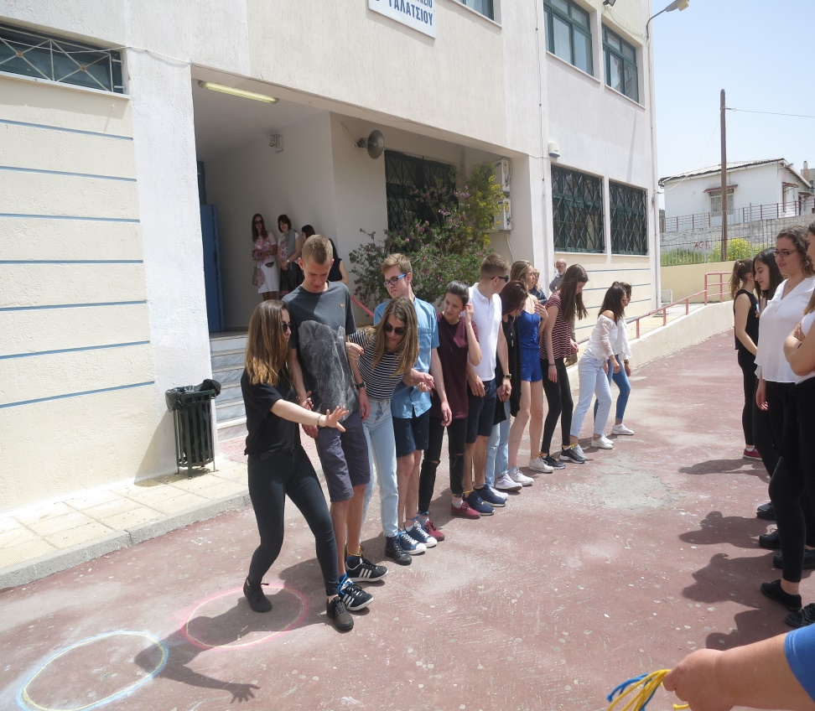
SUNDAY
Our first full day in Greece begun with welcoming all the participants by headmaster of the school and local authorities. Then we had some funny ice breaking activities which helped us to get know each other. After that we ate amazing lunch prepeared by host families. The last activity that day was presenting the presentations about ICT which every country had to prepeare. And then we had the whole afternoon to spent time together in the city.

Slide 4
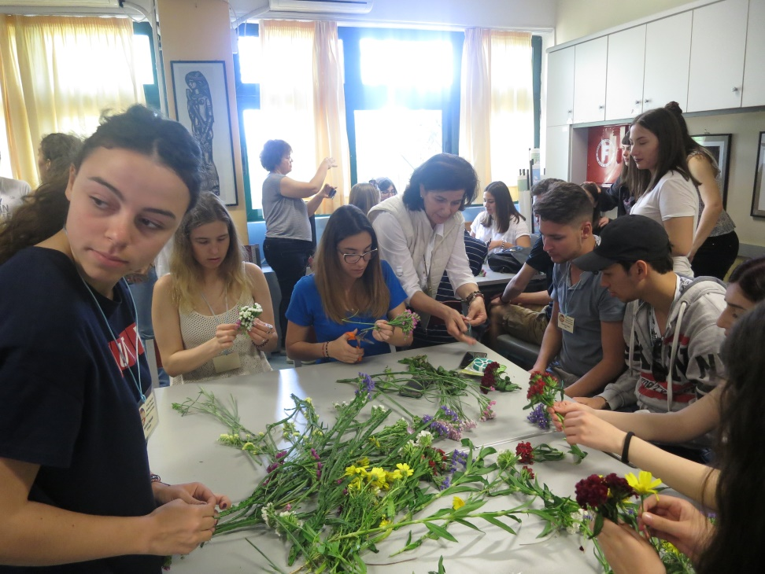
MONDAY
At that day firstly we had workshop for enriching the website of our project. Then we watched Croatian and Greek presentations about ICT. We also filled a Questionnaire which explores their digital competences and potentials. Our last exercise was to made a decorations for school for the 1st May. And after that we had freetime which we spent visiting centre of Athens.

Slide 5
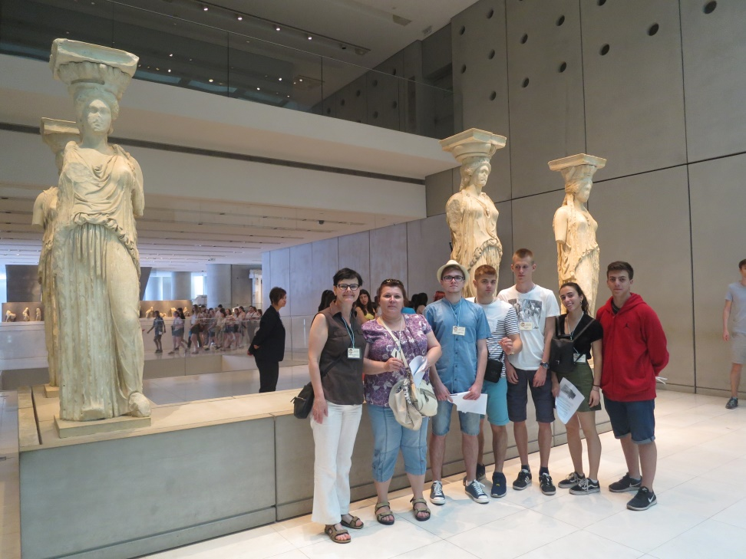
TUSEDAY
This day was of the most exciting. We were visiting Acropolis museum and whole Acropolis. We saw some beatifull ancient mounuments and landscapes of Athens. Then we had time for lunch and we ate typical Greek food called Souvlaki. Next attraction was „Escape room”. We were divide into international groups and we had to solve difficult exercises using our inteligence and logical skills. That activity was good to integrate with other participants. That was the last activity of a day so we had freetime again to spent it with ours hosts.

Slide 6
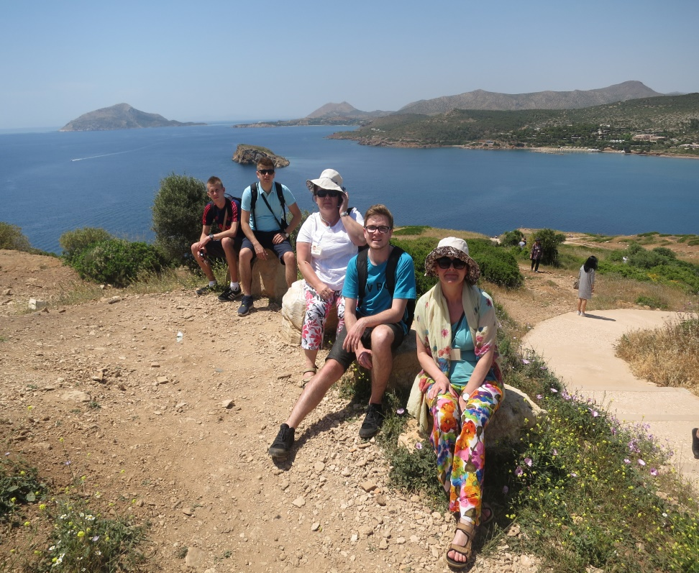
WEDNESDAY
We started that day with visiting Greek ICT company called „Space Hellas”. Three persons who are employed in that company told us about what type of work we can in ICT and what skills we need to become good worker as for example programist. We were impresed by numer of companies that Space Hellas work with. We have also seen how employes during work. Then we visited cape Sounion where we saw Posejdon’s temple and beatiful landsape of islands and seaside. After that we ate great lunch with Greek meals. We also had Chance to swim in the sea so we did it!

Slide 7
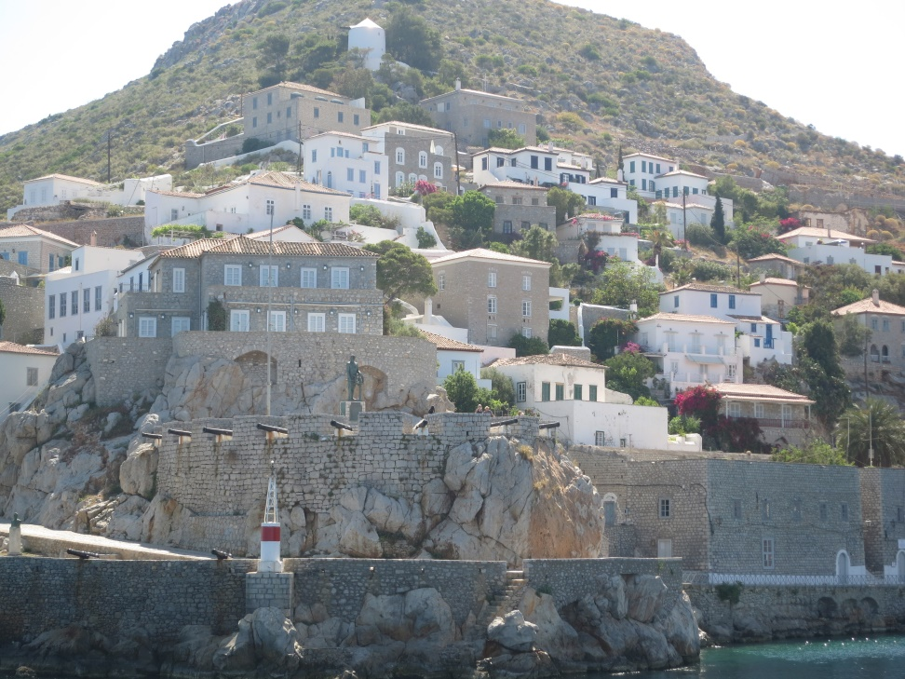
THURSDAY
That day was the longest one from the whole Erasmus. We were on a cruise and we visited three islands: Aegina, Poros and Hydra. All of the islands were beatiful with the landscapes. We spent all time walking on the islands, sunbathing on the ferry and swimming in the sea again! We ate very good lunch on the ship with Greek meals of course. We had also Chance to participate in show with Greek music and dances. After the cruise we went straight to our homes.

Slide 8
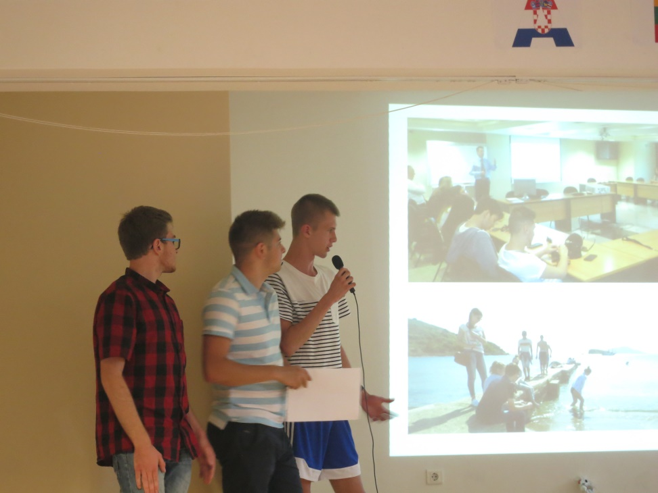
FRIDAY
Friday was the last full day in Greece and also last day of whole project. We begun with given us feedback of questionnare that we fill first day. We talked about how we can improve ours ICT skills and how to solve problems connected with ICT. Then we all participate in game which simulated working in a company. We were divided into four groups we have to get the best result for the company but also for the team. After that we had some freetime and then we ate lunch made by our host’s parents. Next there was a evaluation of the project. All the countries had to say what we were doing during each day in Greece. Then we had a Goodbye Ceremony in school. Everybody got special gift which include handmade soap and Greek jam. There was also a party at school with Greek and international music when we had good time dancing. After that all the people meet together in park to spend last hours of our residence in Greece.

Slide 9
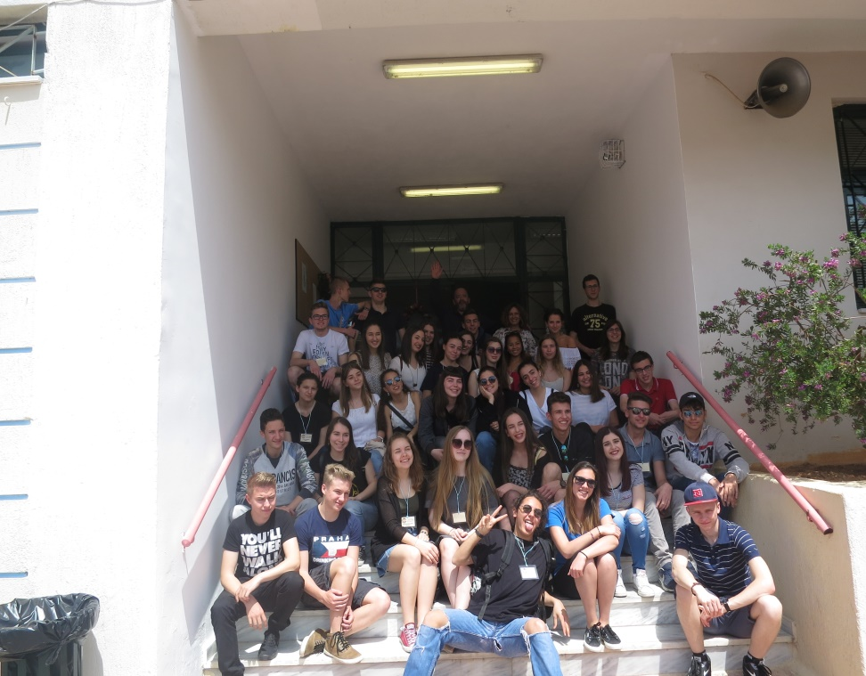
SATURDAY
That day was the saddest one because we were leaving ours hosts and Greece. We woke up very early, go to the hotel where teachers where staying and that was the moment we had to say goodbye to our friends who host us for a week. All of us recive special gifts from hosting families. Then we went to airpory and came back to Poland.
That project was unforgettable expierence. We had visted beatiful country, met amazing people and improve ours language skills. We will never forget that project and we hope that once time we will meet again.

