Slide 1
What is it made of?
Who invented it?
What was it made for?
How does it work?
How is it made?
Why was it made?
What is it made of?
How do you use it?

Slide 2
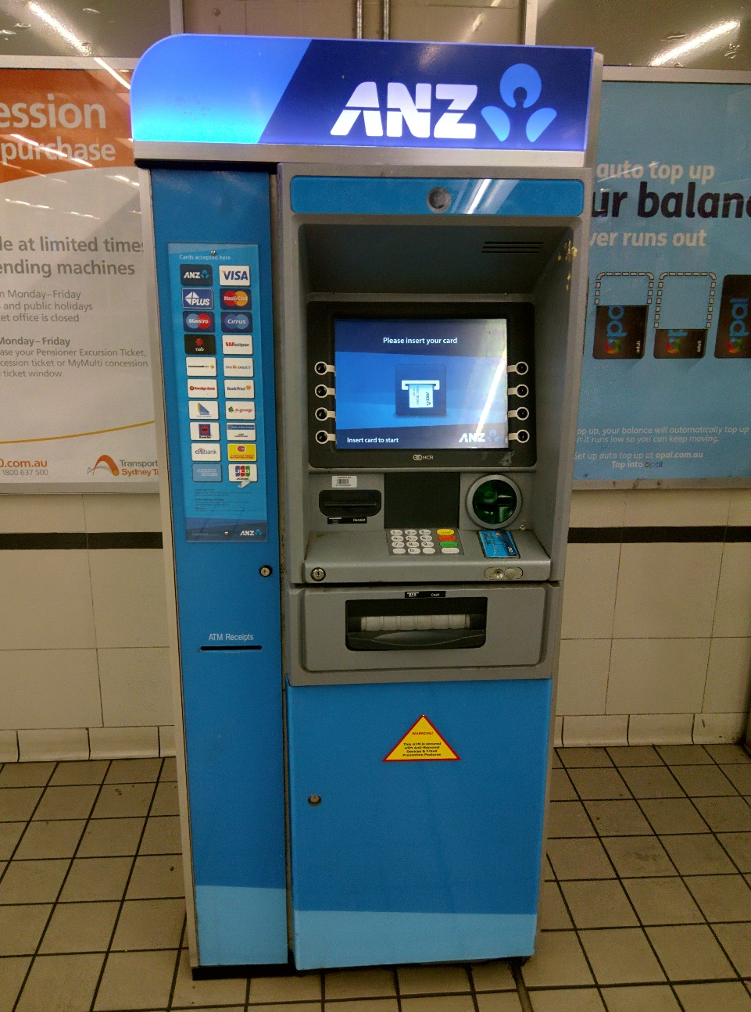
ATM
Automated Teller Machine
It’s a specialized computer that makes it convenient to manage money transfer.
ATMs allow you to withdraw money, and many allow to make deposits.
At some ATMs, you can print a statement (a record of your account activity or transactions).
You can check your account balances
(the amount of money in your accounts right now).
You can transfer money between your accounts.

Slide 3
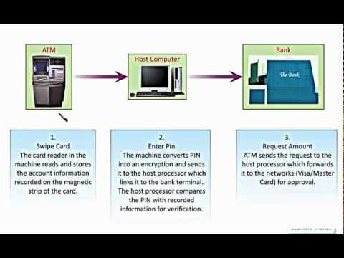
How does an ATM work?

Slide 4
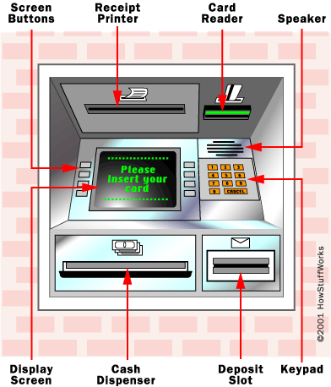

Slide 5
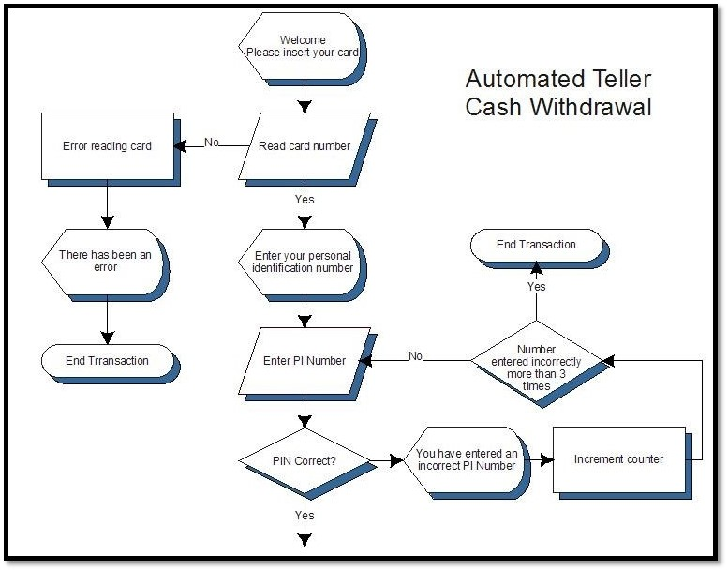

Slide 6
What’s behind the scene?
https://www.youtube.com/watch?v=cYWHqha2wfk

Slide 7
Thank you for your attention!!!!!
The Polish team

