Slide 1
Scientific articles presented in the Internet

Slide 2
What is a scientific article?

Slide 3
A scientific article should include :
Abstract - a short summary of the article (its purpose, method, questions, results, and conclusions.
Introduction - background description of the problem, the purpose, questions, and limitations of the study.
Methodology/Material - description of the methodology and material used by the researcher.
Results of the study, may include interviews, diagrams, tables and figures.
Discussion/Conclusions - results are interpreted
and evaluated.
References/Sources - documents, books and electronic sources are provided in a reference list.

Slide 4
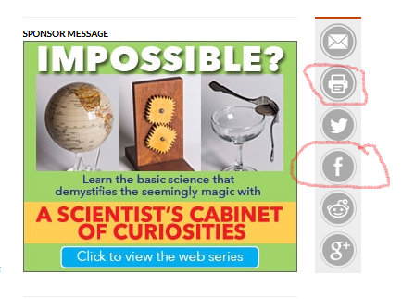
What is the difference between
a newspaper and Internet scientific article ?
Online articles have no problem with space limitation.
They are widely available at any time.
They can be printed and shared.
The texts are shorter and more compact.

Slide 5
They provide interaction - readers can take part in opinion polls and give comments.

Slide 6
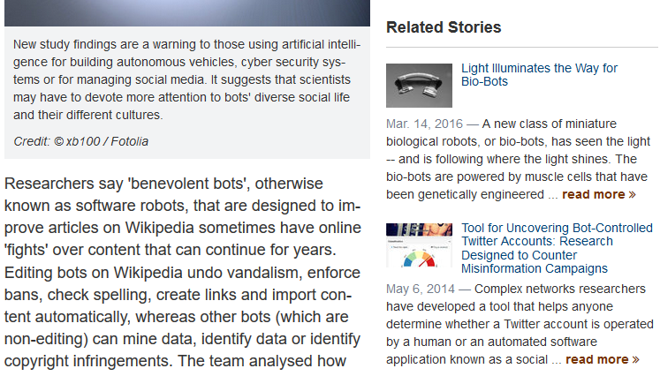
Appearance of links and explanation where user can go with the links.

Slide 7
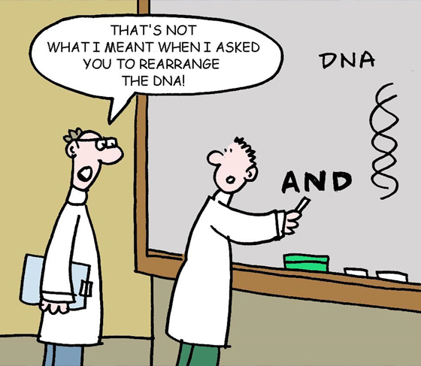
Examples of scientific articles in the Internet
https://www.sciencenews.org/article/ceres-harbors-homegrown-organic-compounds
http://www.bbc.co.uk/blogs/thereporters/rorycellanjones/2011/02/the_turing_papers_saved.html

Slide 8
Thank you for your attention
The Polish Team

