Slide 1
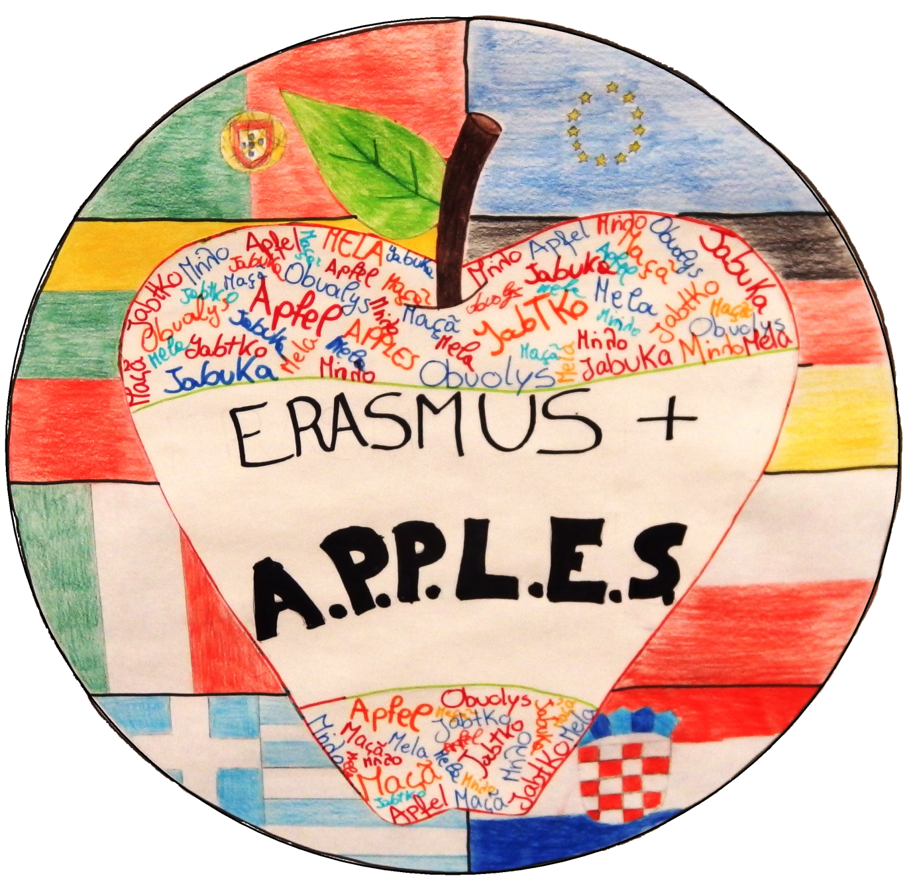
Erasmus +
Croatia 2016
6.03-12.03

Slide 2
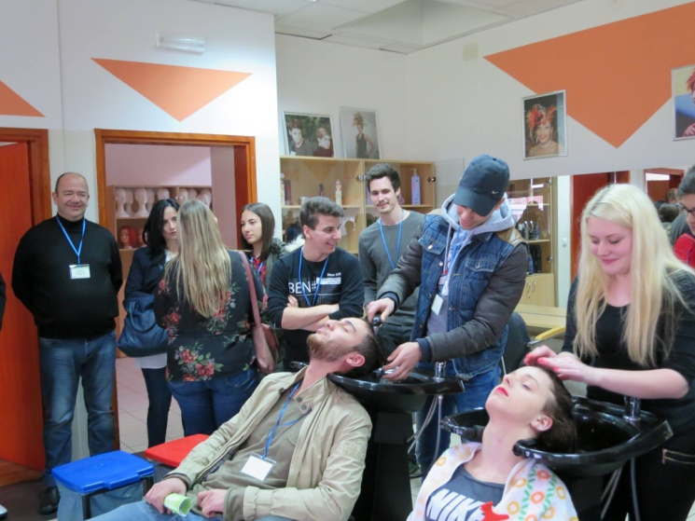
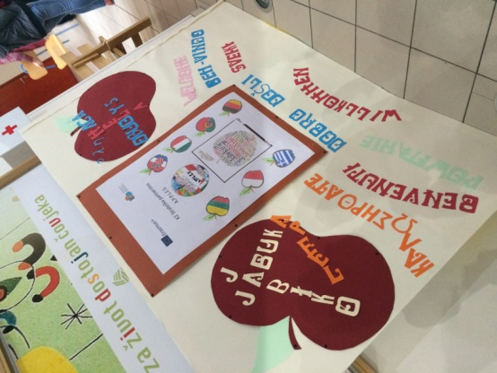
Monday
7.03.2016
First day students were pleasantly welcomed at the school in Cakovec. Then an organizational part began :
Welcome speech
Presentation about Medimurje Country
After that we had first activities, called „ice-breakers”
We had to create the word "apple" of the letters in another language. That exercise was quite easy, we also could get to know each other. Then students from Croatia took us on a tour around the school, we could see classes and were able to use the services of hairdressers.

Slide 3
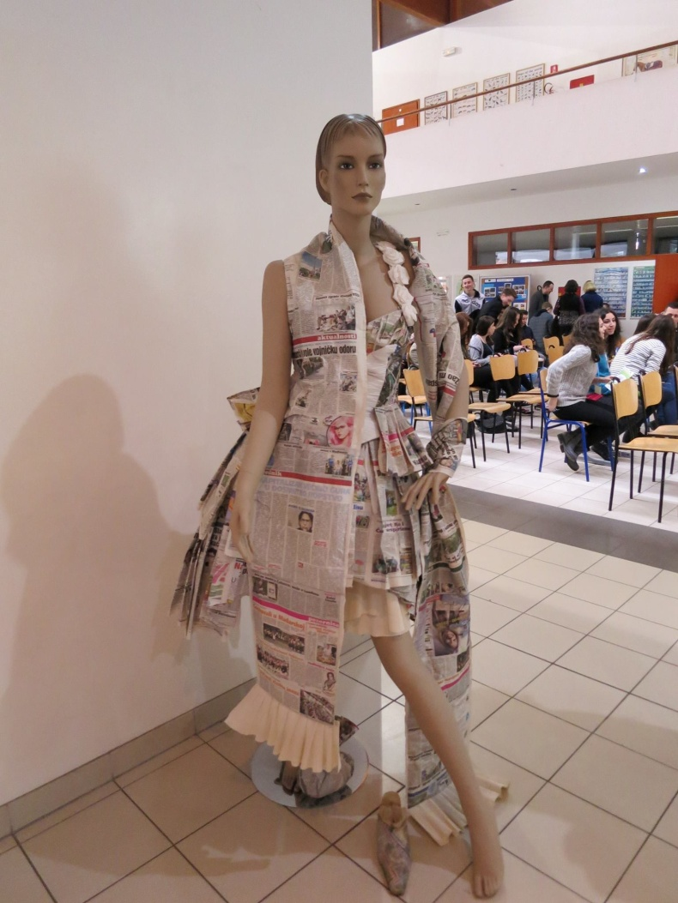
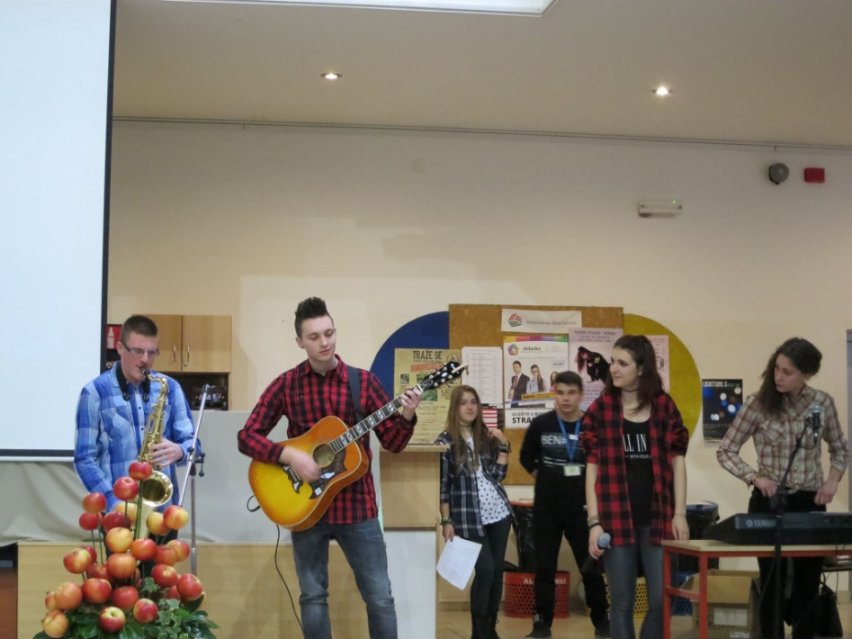
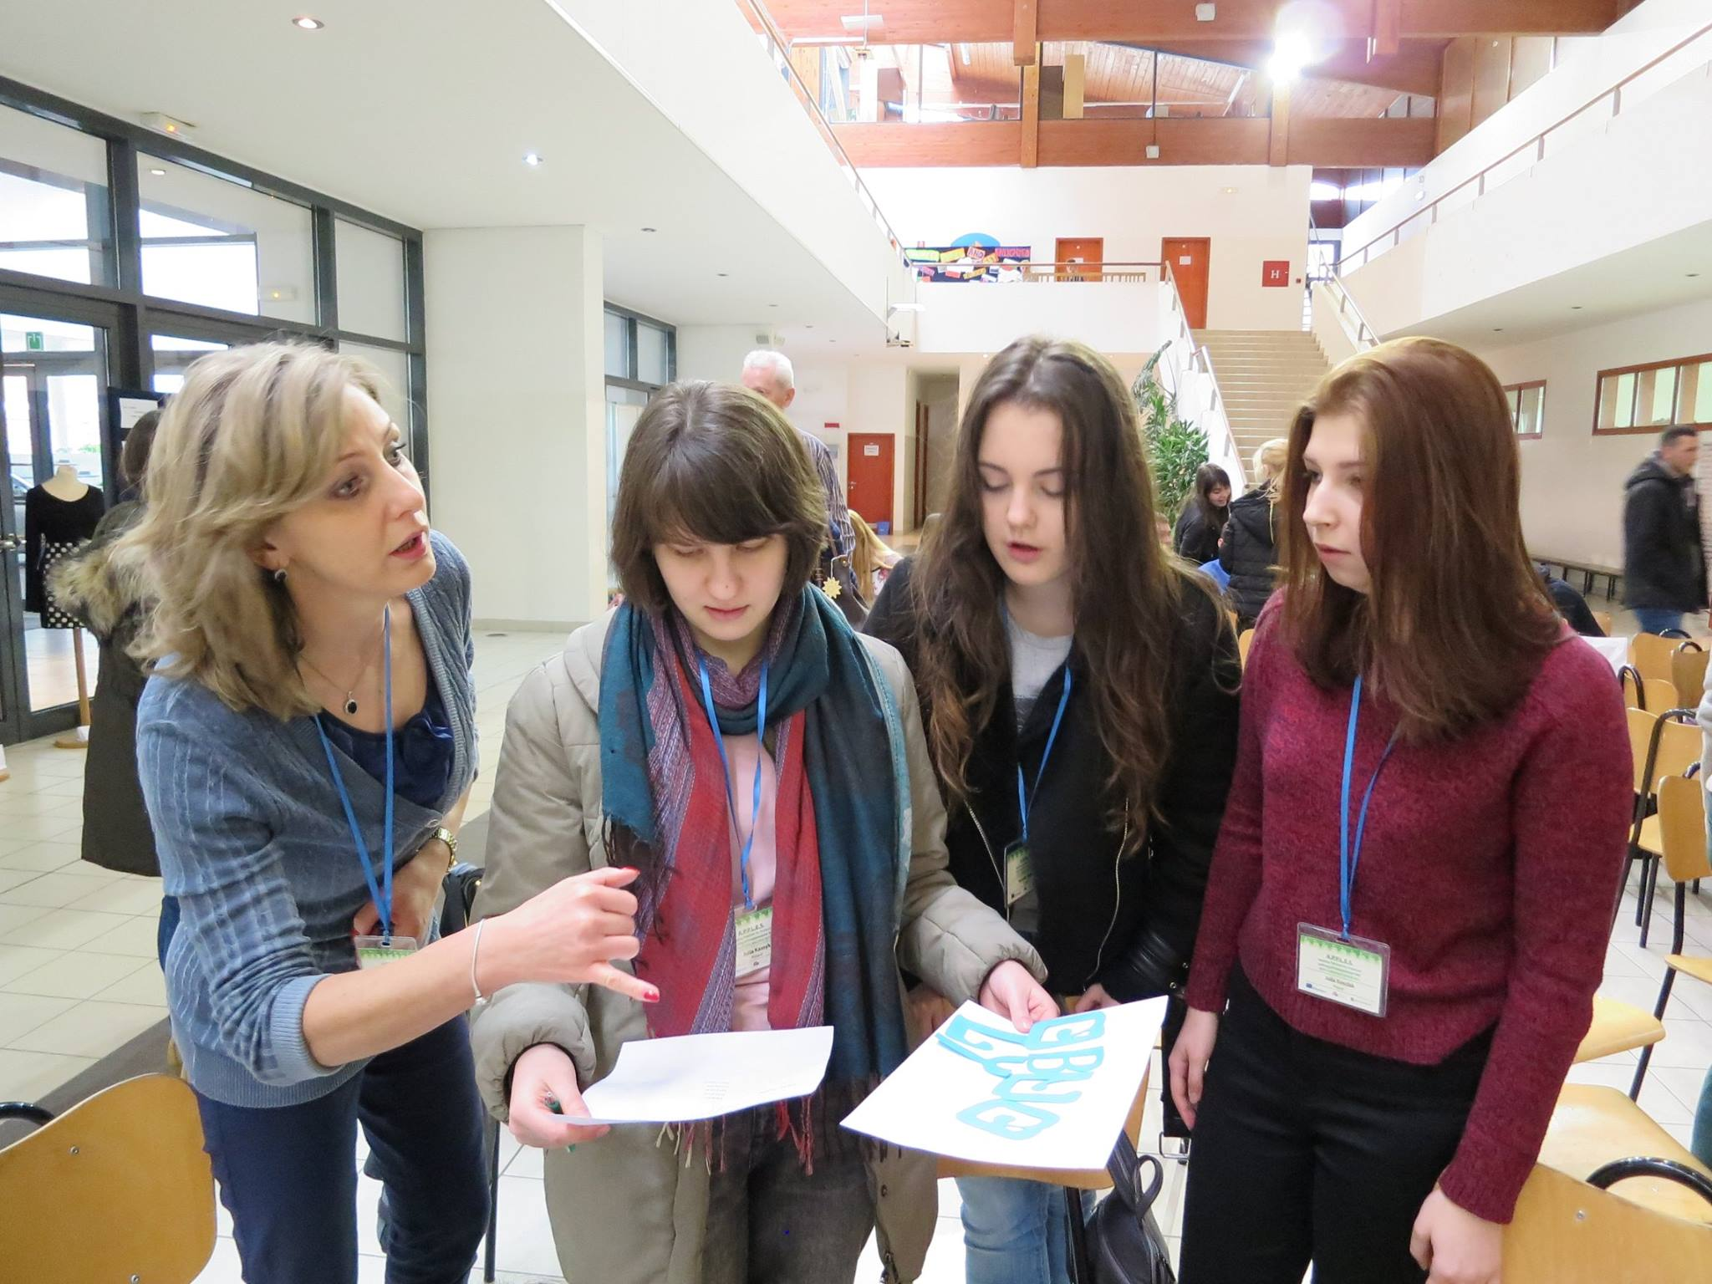

Slide 4
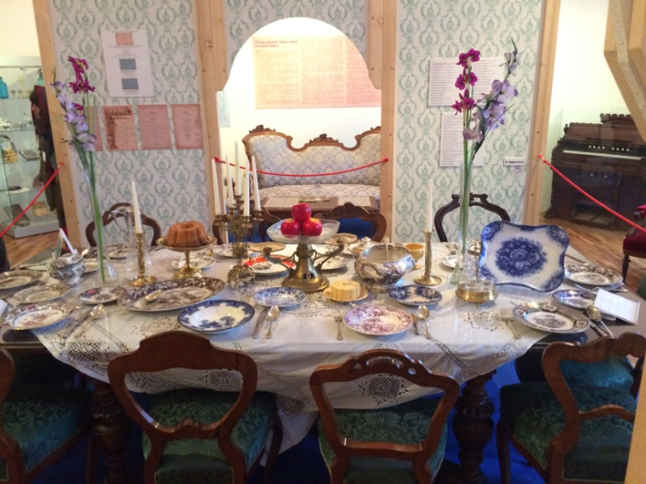
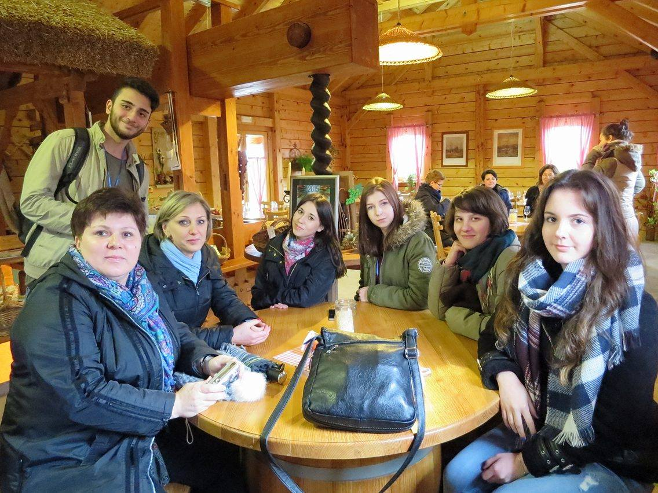
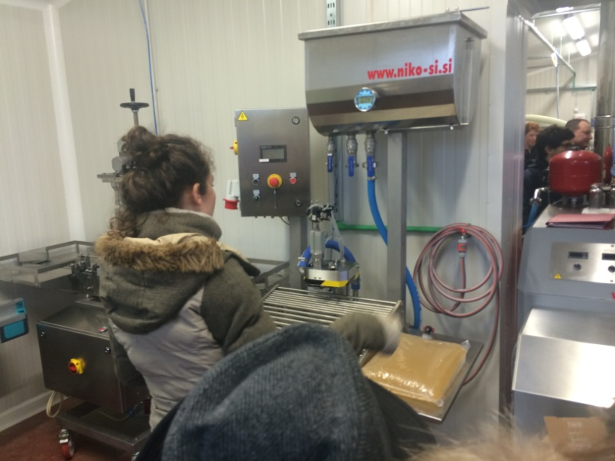
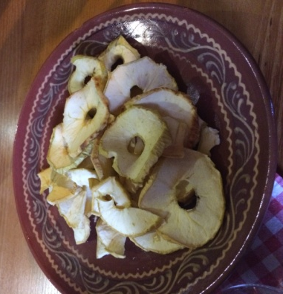
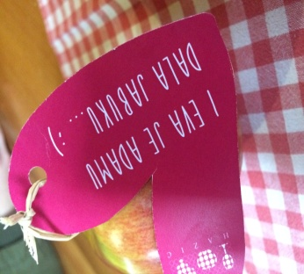
Later we visited a local museum and the Zrinski Castle. There was a presentation on the history of Cakovec. The museum exibits were plenty and very interesting. At the end of the day we visited Hadzic family who produces apple juice, wine and apple chips. We could see how to make fresh juice from apples and we were able to try it.

Slide 5
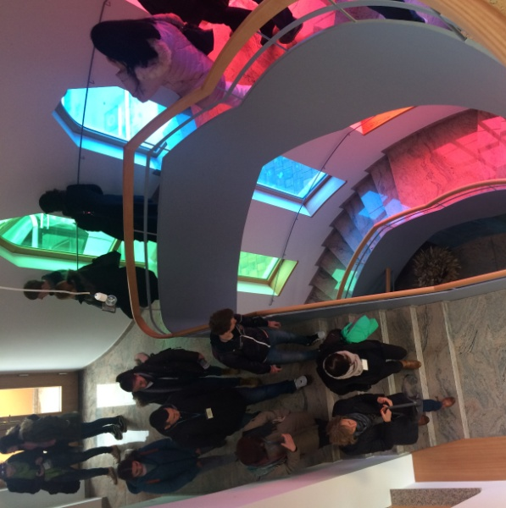
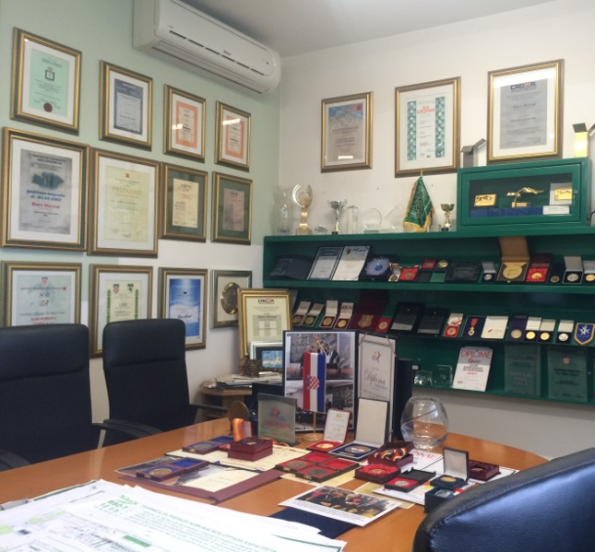
Tuesday
8.03.2016
The second day in Croatia started with visiting "Tehnix" in Prelog. We saw the whole factory, the office and we learned that it gained awards of this ECO industry. After that we went to "Rudolf Steiner Centre" where we listened to lectures about this person. He is a very important person in the Croatian history.
We also found out how to make compost.

Slide 6
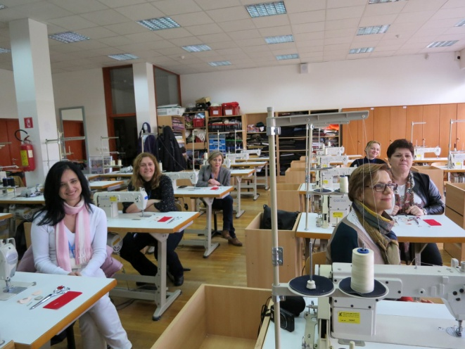
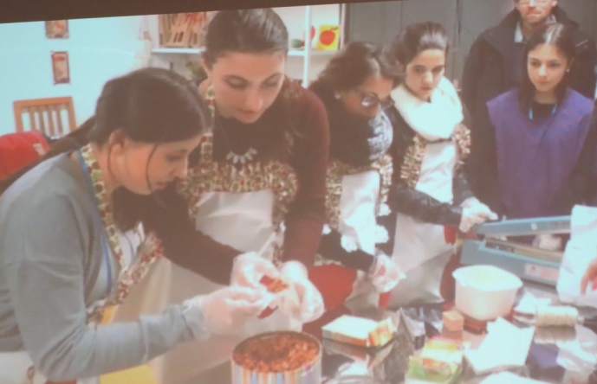
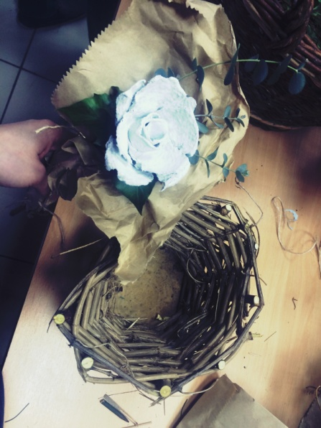
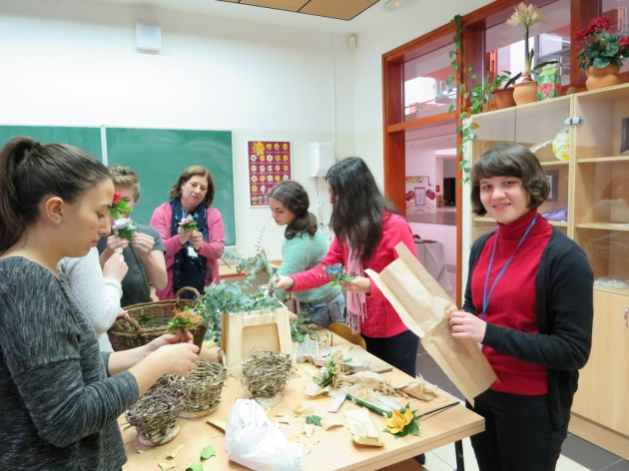
. Then we had lunch and we came back to school for our workshop activities, where we made something from nothing. Just recycle. ☺
Students were divided into few groups. Each of the group did something different. Some of us made wooden brackets and flowers from eggs cartoons. There was also a group which made furniture from wooden pallets, apple chips and packed tea into paper bag.

Slide 7
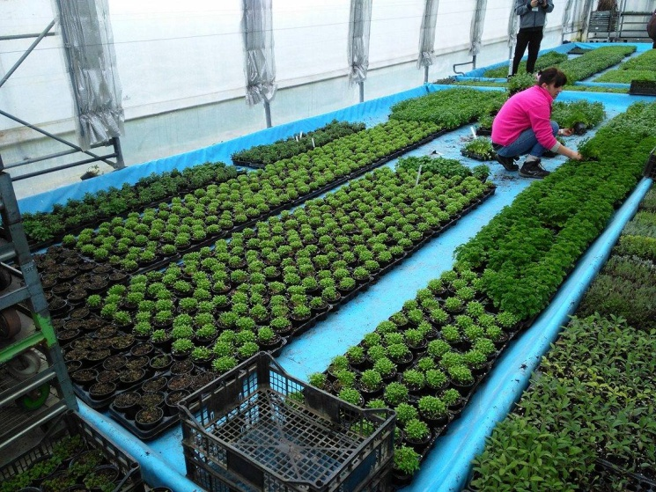
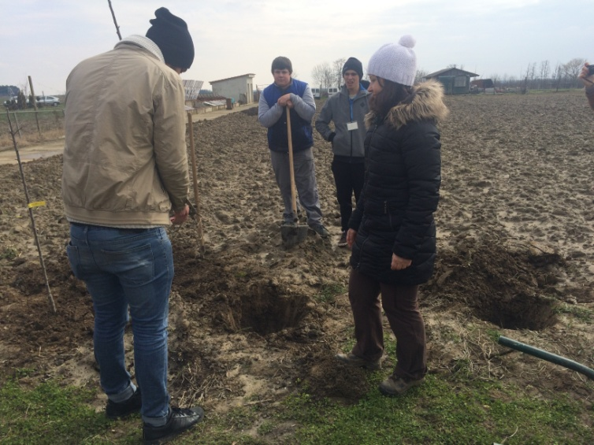
Wednesday
9.03.2016
We all gathered in front of the Park Hotel at 8 30 AM. After few minutes we went to a farm called Biodynamic Garden. At nine we had a tour around the farm. We saw achievements of labor of the local workers. Next step in our tour was witnessing how compost was made. Finally we were shown how to properly plant seeds.
After 3 hours of free sightseeing of the farm we came back to the meeting point.

Slide 8
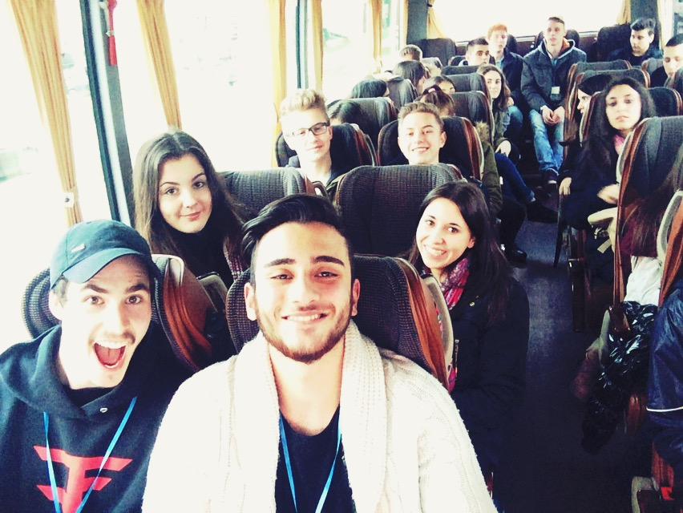
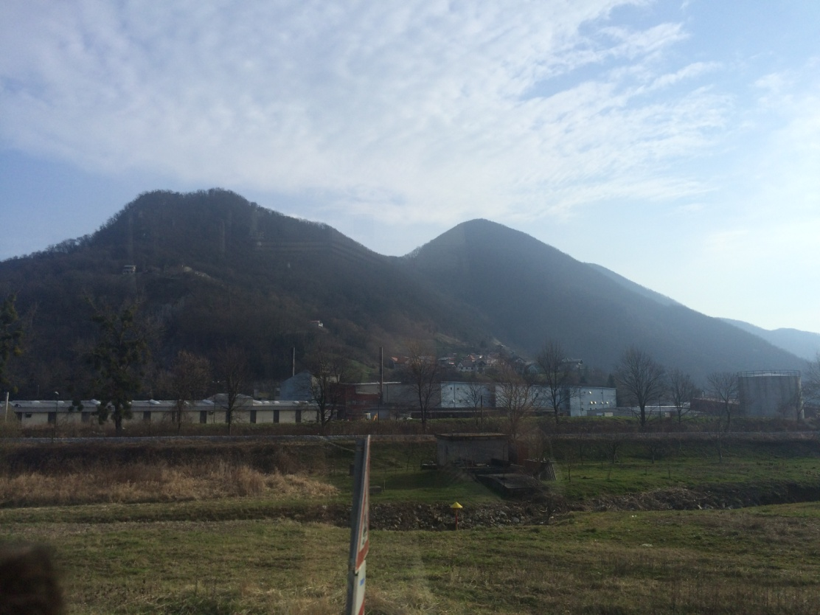
Then all of us went bowling.
It was a great day!

Slide 9
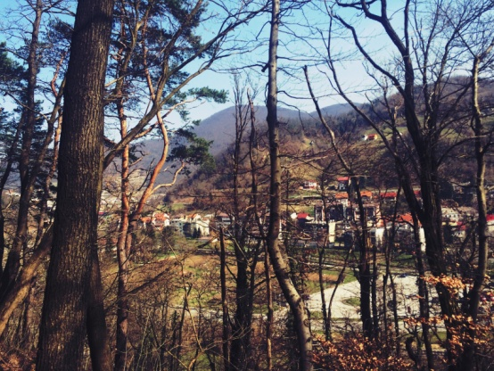
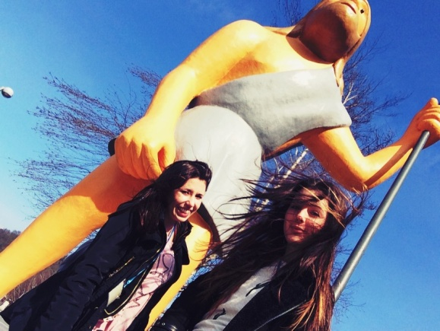
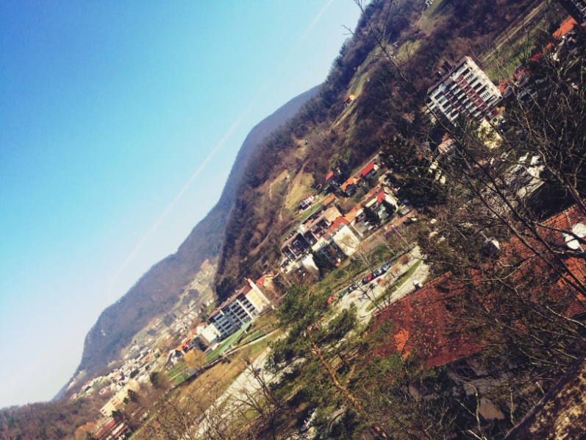
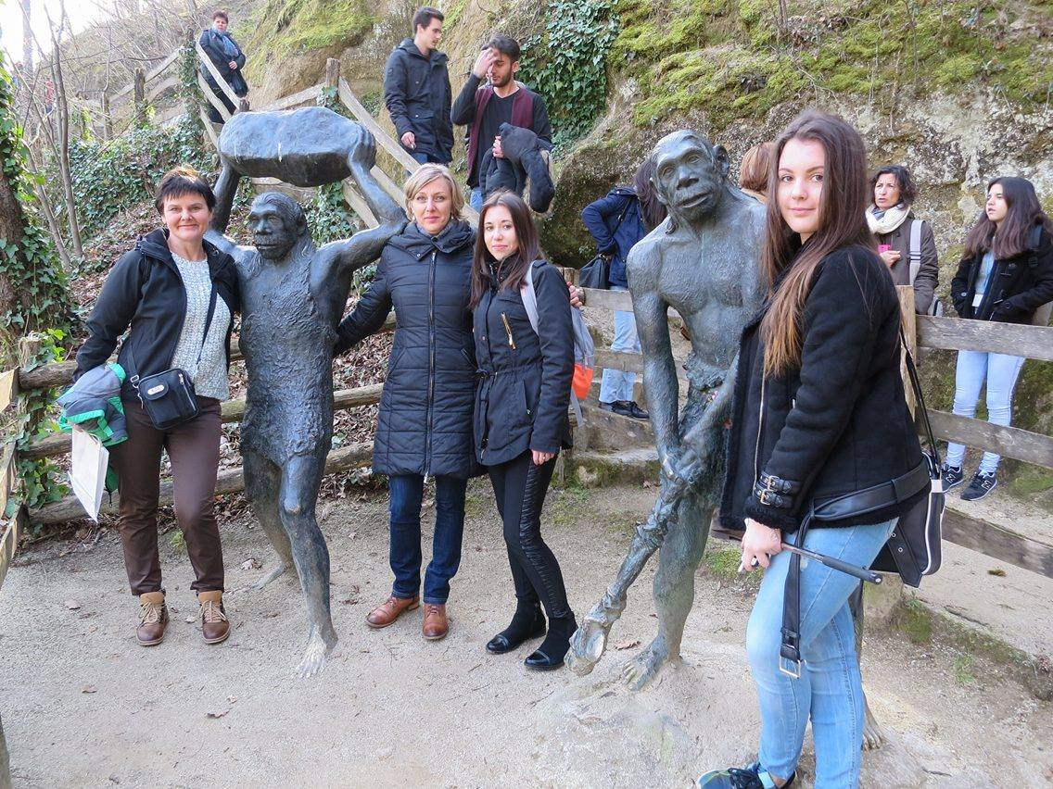
Thursday
10.03.2016
. On Thursday there was a bus trip. First we went to Krapina where we visited the museum of Neandertal. We saw a very interesting exhibition and found out a lot of new things from the field of history of the world and organisms living on it.
That museum was a real highlight of our trip.

Slide 10
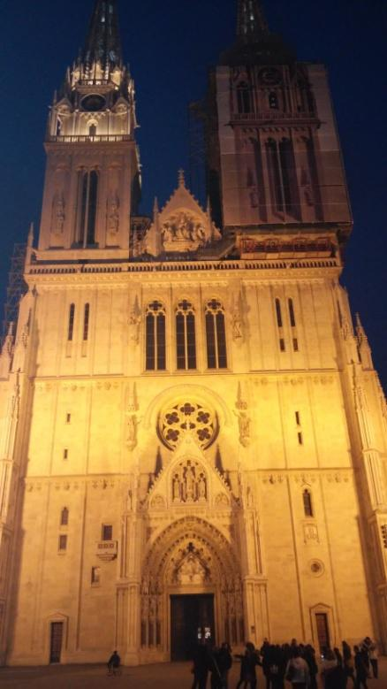
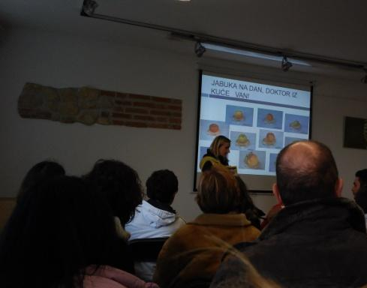
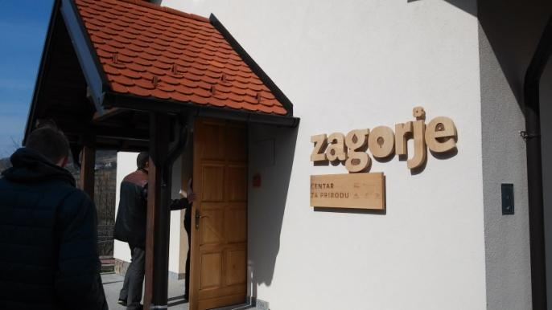
Later we went to Radoboy, to the Public Institution for Managment Office Protected Natural Areas Krapina-Zagorje Country, where we listened to a lecture about the nature of that country.
Then we went to Zagreb, the capital city od Croatia, which we explored individually.
It is a really beautifull city with gothic cathedral and lots of richly ornamented tenements.
We also had time to go for a coffee or shopping and we spent some time with our friends from other countries.

Slide 11
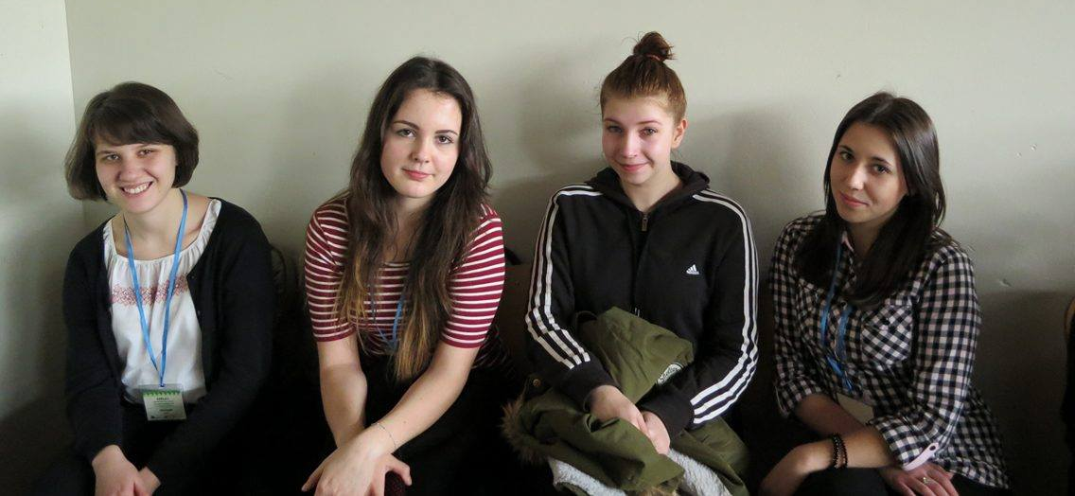
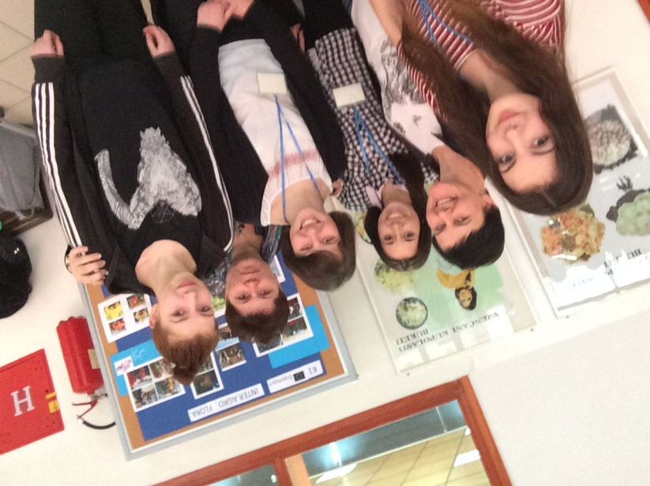
Friday
11.03.2016
It was our last day in Croatia. At first we had some activities at the school, then a lecture about Pinova Company, at the end we had a closing ceremony when we showed our presentations about workshops we made.
The rest of the day we spent hanging out with others, we went to a party and we had a fantastic time ☺

Slide 12
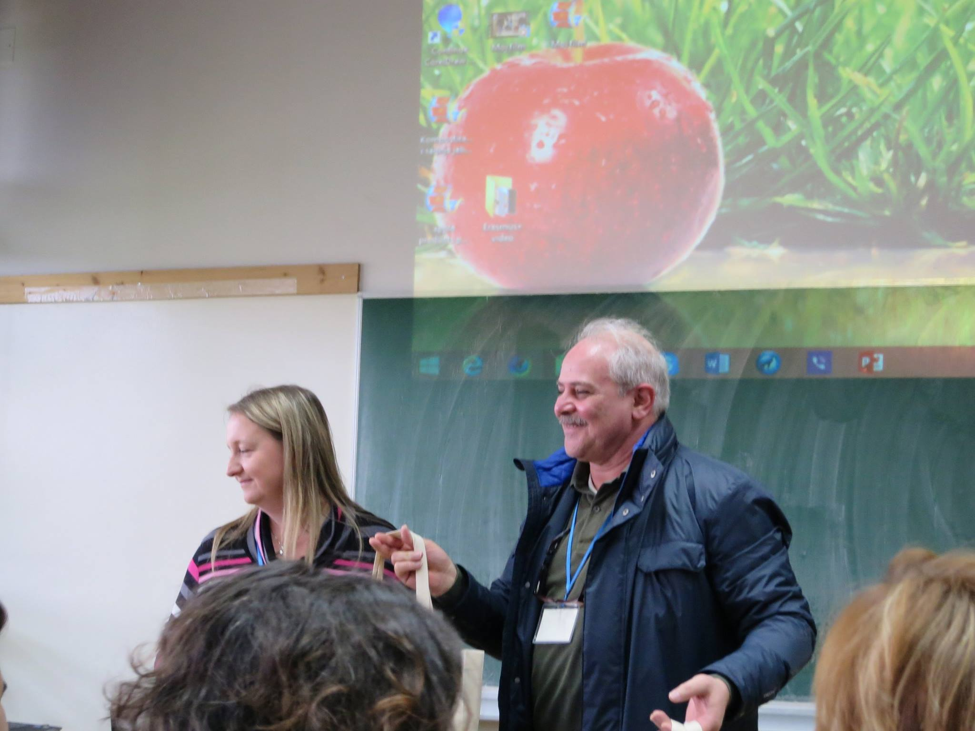
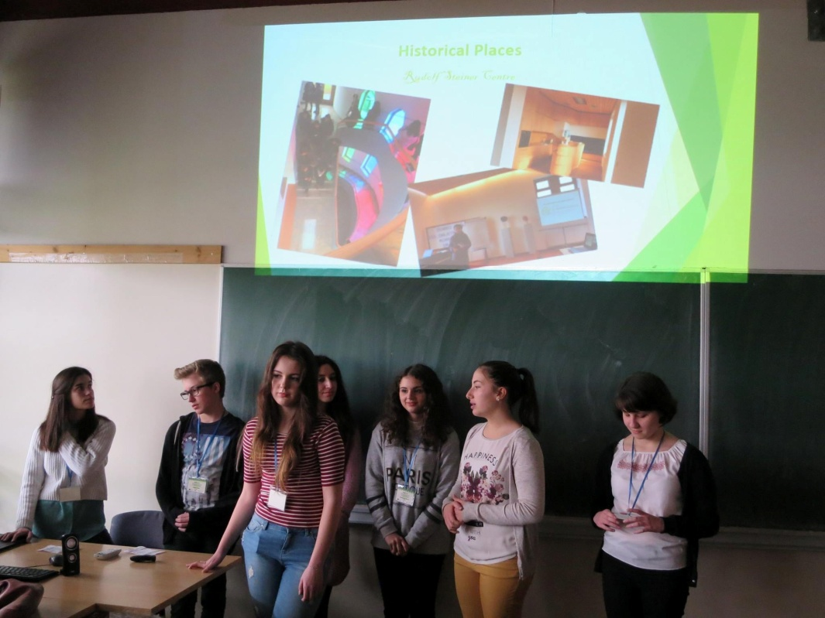

Slide 13
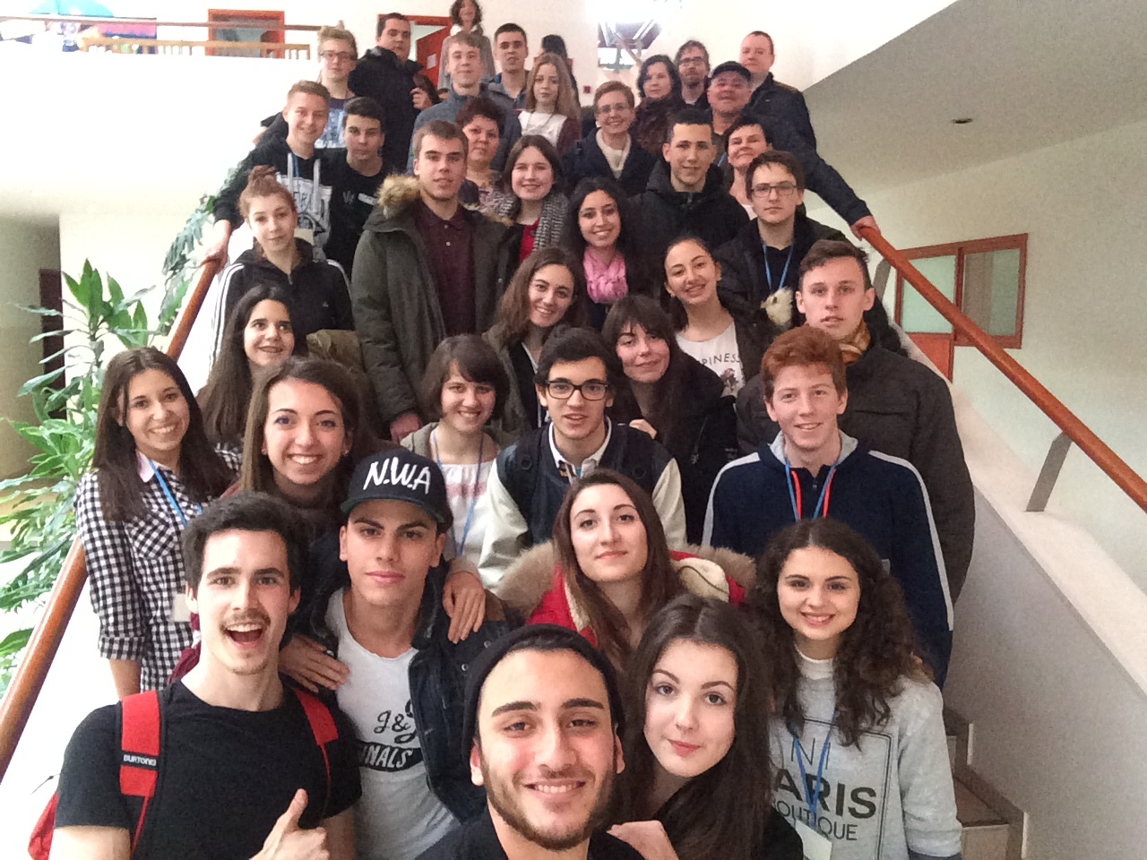
IT WAS A GREAT TIME THERE :)

