Slide 1
A visit in a company (at school)

Slide 2
School system in Poland
We start our education with a kindergarten.
Then, after from 1 to 4 years, we go to primary school for 6 years.
After that we can either have a year of rest or go to the gymnasium for 3 years.
Then we can choose between technical school (4 years), vocational school (3 years) and secondary school (3 years).
This school is the secondary school, where we can choose our extended subjects.
The best mark we can get is 6 and the worst is 1.

Slide 3
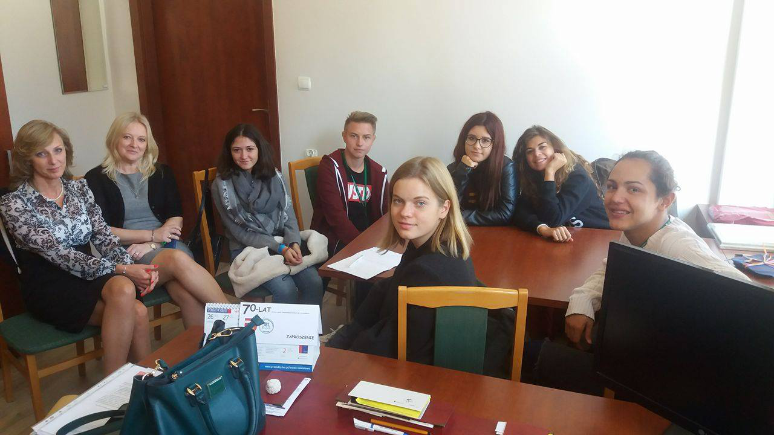

Slide 4
Question: How many employees are familiar with first aid?
Answer: Every employee is familiar with first aid. Two people have a certificate of first aid and they can teach others how to practice first aid.

Slide 5
Q: Is at this school a shop with healthy food? What can we buy there?
A: In accordance with the law in Poland in this school is a shop with healthy food. You can buy there for example a fresh juice, vegetables, fruits and salads.

Slide 6
Q: Do the teachers and students have a health insurance?
A: They have a health insurance. It protects them not only at school but also beyond school. ( In their country and abroad)

Slide 7
Q: How many holiday do the teachers have?
A: They have six weeks off work on summer and two weeks on winter.

Slide 8
Q: How this school take care of teacher’s health?
A: They have a health examination every three years. They also get tickets to the swimming pool, they don’t pay for it.

Slide 9
Q: Do you organize sports events and trips for teachers?
A: Yes, we organise sports events and trips about 2 times a year or more if teachers want to take part.

Slide 10
Q: How do employees go to work?
A: It depends on where they live. If they live next to school they go by foot and some of them go by bike. If someone live far away they have to go by car or bus.

Slide 11
