Slide 1
How to protect health at job place?
„Health isn’t everything but everything is nothing without health”
Artur Schopenhauer

Slide 3
How PKO Bank disseminates health topics in their activities?
My benefit – web platform where every bank employee has an access to account allowing them full over the funds from the company social funds like:
cinema tickets;
trips abroad;
summer camps for children;
gift cards to online shops.

Slide 5
How PKO Bank spread informations about health in their branches?
-Charity runs which helps people in need;
-Sport card in few programmes like MULTISPORT, PURE,
OK System;
-”PKO after working hours” – supproting employees imiatives leading to integretion thought donating sport, cultural and international events.

Slide 6
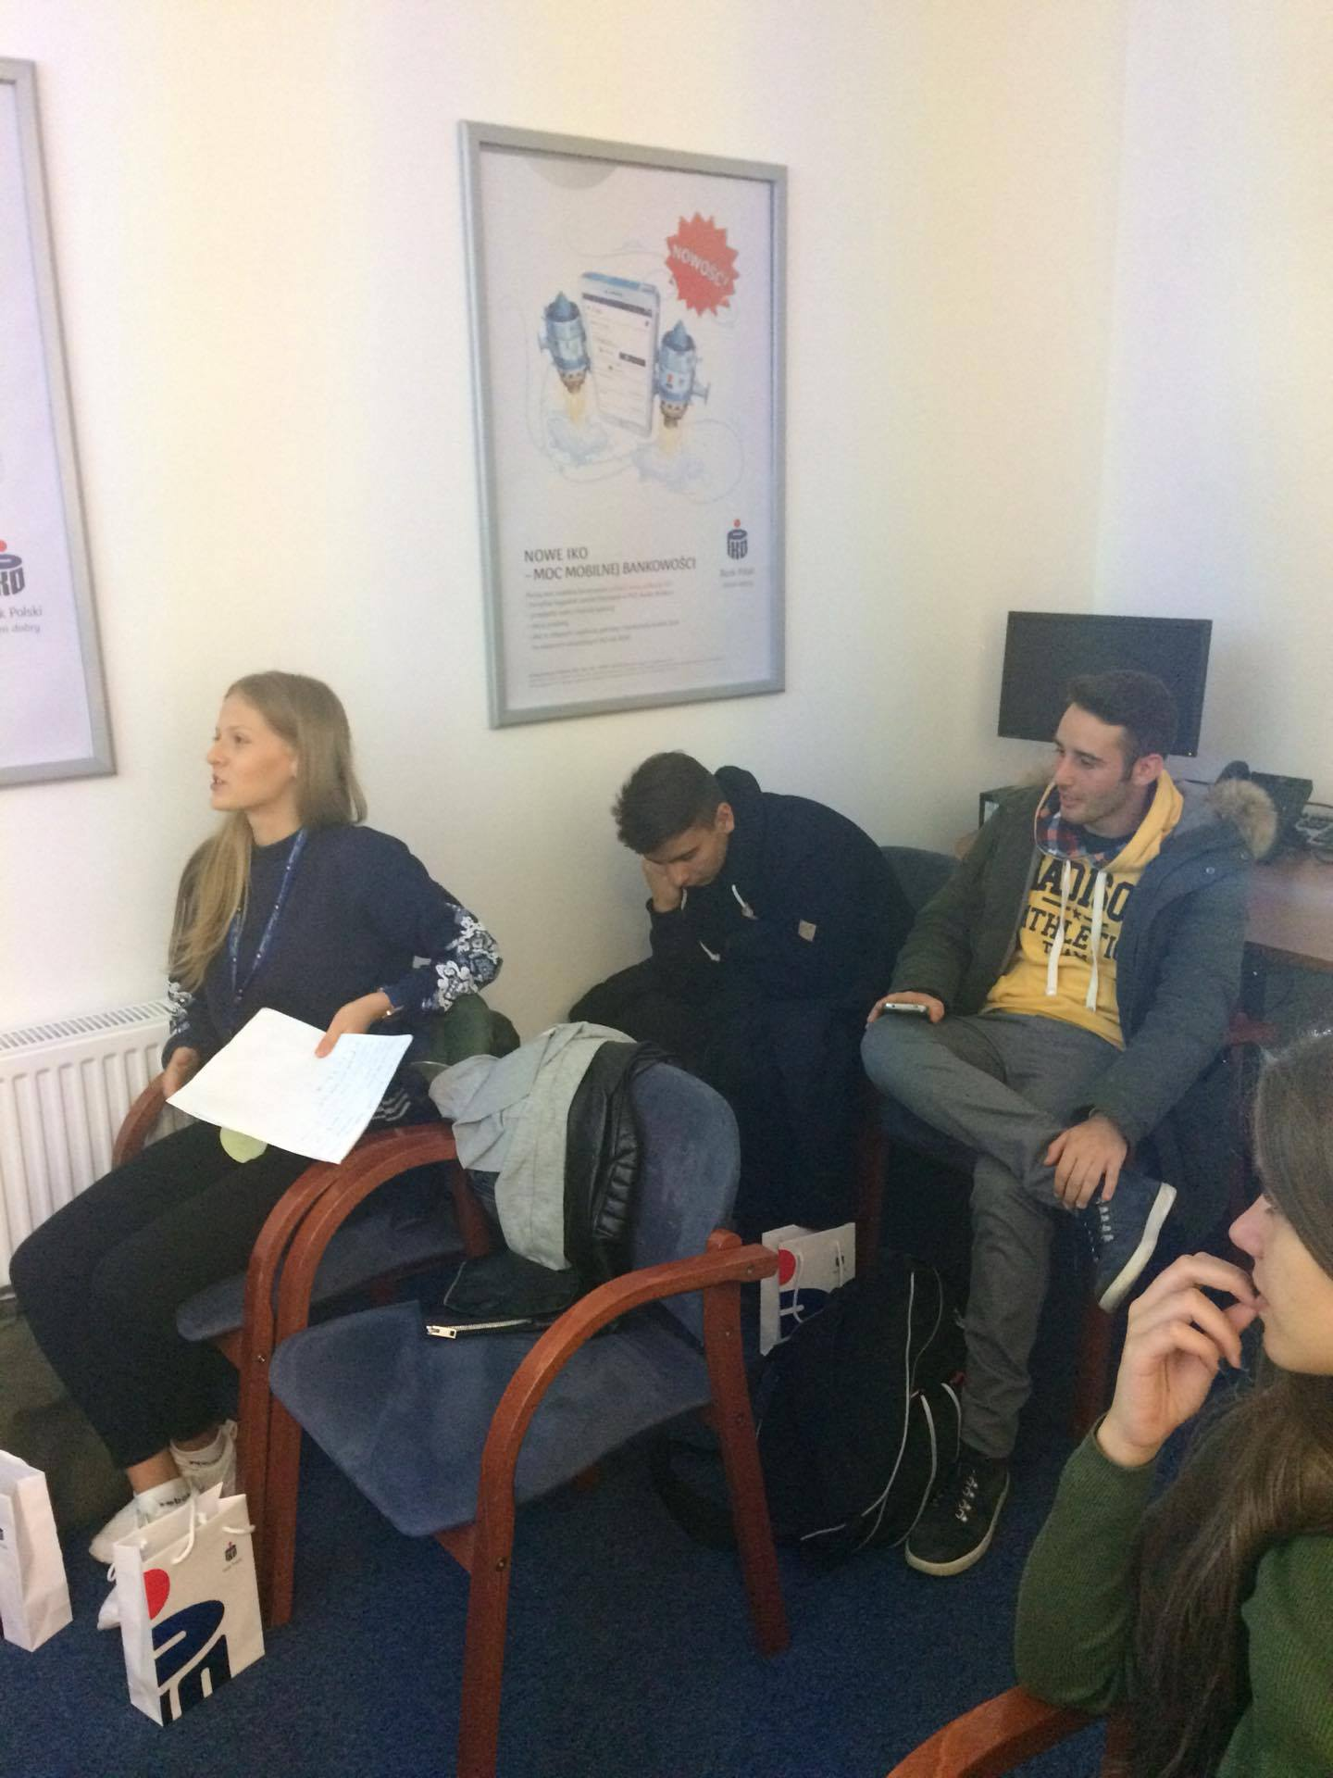

Slide 7
How PKO Bank support the families of employees?
- Family members of employees and members of their family can have a healtcare package bought trought the Bank;
-Former employees and members of their families and family members of Bank retirees through Bank can use fee-based continuation of healthcare.

Slide 9
Thank you for your attention! ☺

