Slide 1
sanepid

Slide 2
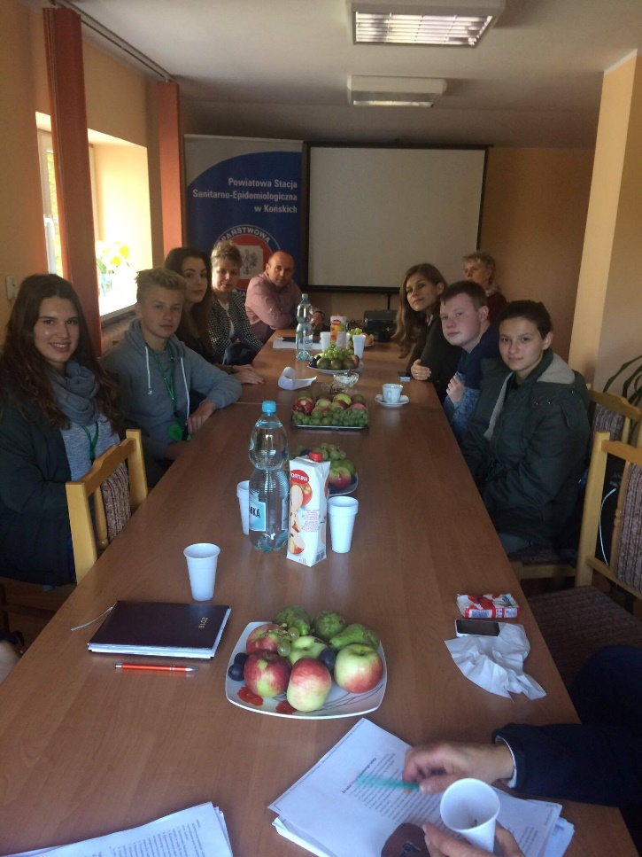
Our visit in the sanel of końskie.

Slide 3
What they do
Inspect workspaces to make certain that customers and employees alike are safe.
Prevent epidemics.
Check food and cutlery for poisons.
Analyse architecture plans of public buildings (escape routes).
Make sure that the burial of the citizens is performer in a sanitary way.

Slide 4
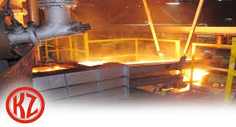
The local metal factory

Slide 5
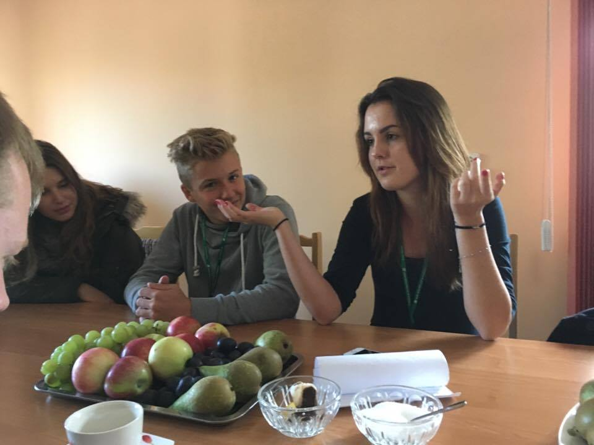
Our kind translator

