Slide 1
Erasmus + Week in Poland

Slide 2
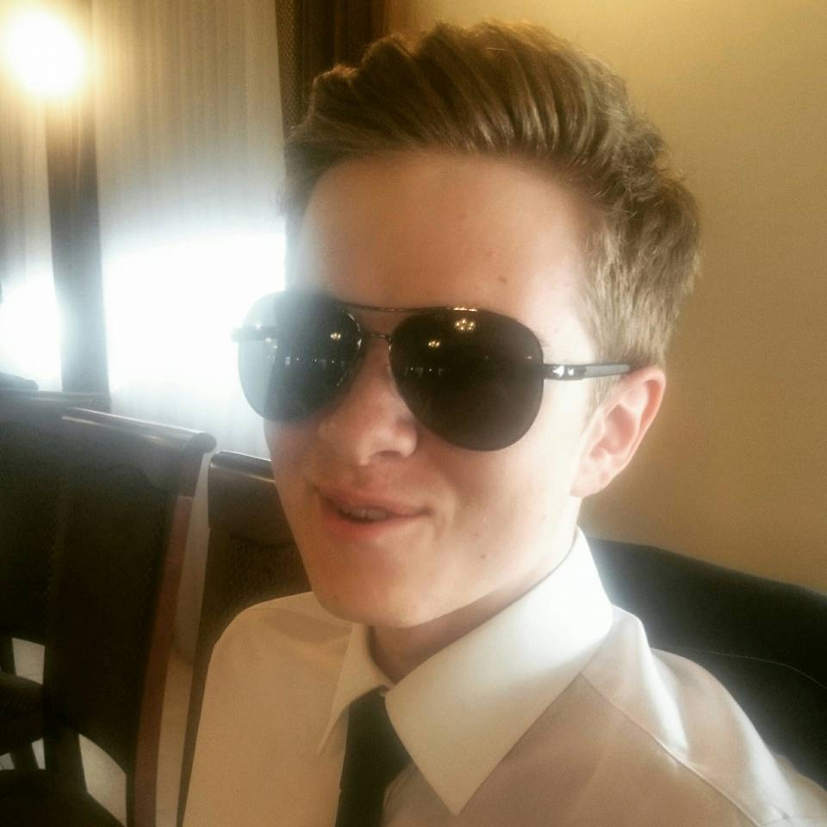
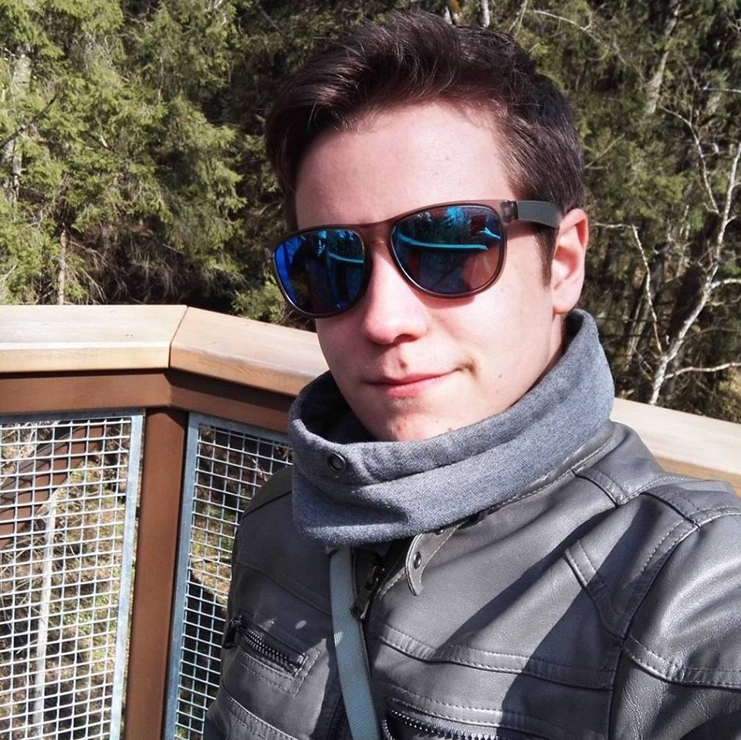
TEAM RED
Laura Rybak
Dominik Chendoszko
Paweł Mijas

Slide 3
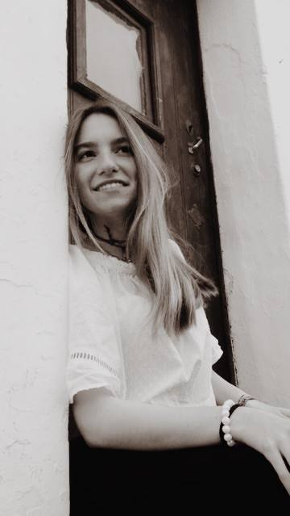
Nefeli Koutala
Matilde Salgueiro
Elisa Bertino

Slide 4
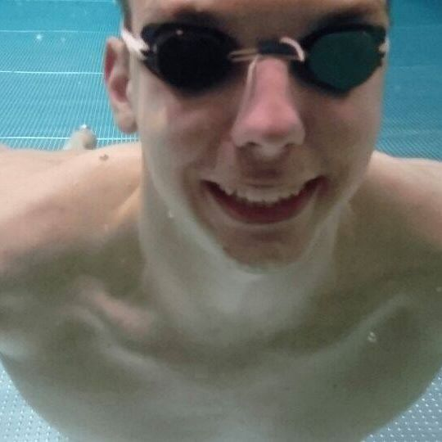
Lukas Misiūnas
Simon Runge

Slide 5
City Hall
We had a lot questions about functioning this company. We asked about education system, future plans for Końskie. They explained us how much money they spend for students and for city development.

Slide 6
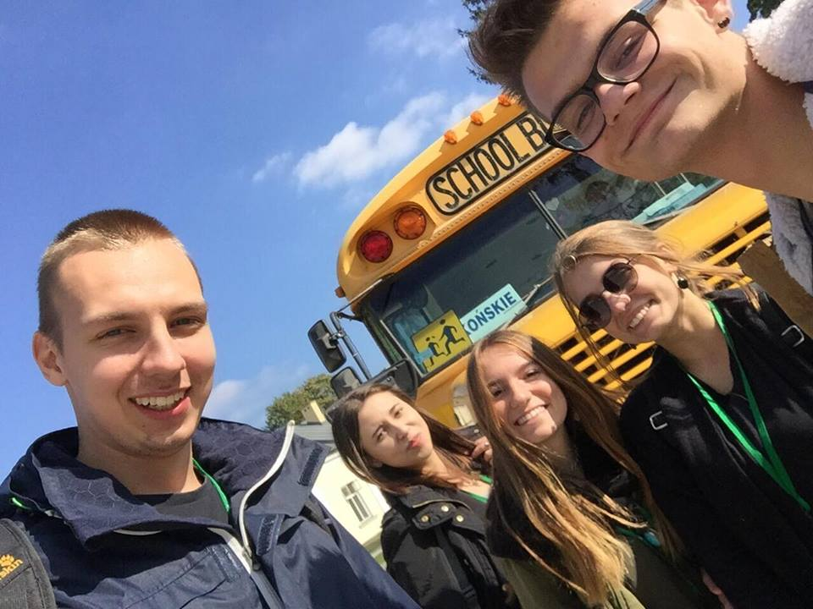

Slide 7
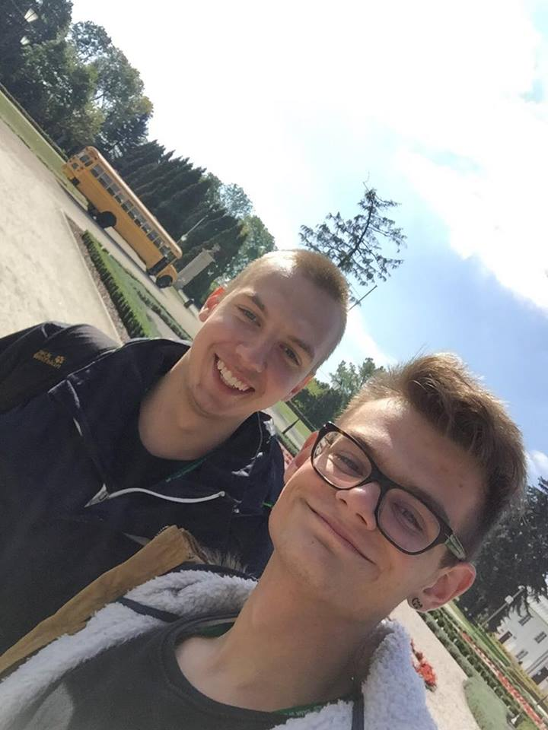

Slide 8
GARBAGE DUMP
After city Hall we went to garbage dump. There we were guided in the premisses of this company and we saw how people work there.

Slide 9
Thank for your attention.

